Slide 1
Advance Java
Java Script Objects
LEVEL – PRACTITIONER

Slide 2
About the Author
Created By: | Renjith(t-renjith)/ Shanmu (105110)
Credential Information: | Trainer / Sr Architect
Version and Date: | 1.0, January 21’st 2012
Cognizant Certified Official Curriculum
Notes:
For tde animators:
tdis screen content needs to be rendered in tde flash, no animations needed.

Slide 3









Icons Used
Hands on Exercise
Questions
Tools
Coding Standards
Test Your Understanding
Case Study
Best Practices & Industry Standards
Demonstration
Workshop

Slide 4
Objectives
After completing this chapter you will be able to understand:
Document Object model of java script.
Java script inbuilt objects.
Java script event handling.
How to do HTML form validations using java script?

Slide 5
JavaScript DOM
JavaScript is designed on a simple object-based paradigm.
An object is a construct with properties (variables),methods or other objects.
JavaScript uses an object model known as Document Object Model (DOM) to navigate through the HTML document in an hierarchy.

Slide 6
Document Object
Each HTML document loaded into a browser window becomes a Document object.
DOM represents HTML elements in a Tree structure.
Every elements in a HTML document is represented as a node.
DOM can be used to change, add, or delete HTML elements.
Java Script access elements of the HTML document using the document object.
DOM nodes accessed through the following methods,
getElementById() : Returns the element specified by the ID
getElementsByTagName() : Returns the list of elements with the specified tag name.
For more Details on DOM visit
http://www.w3schools.com/htmldom/default.asp

Slide 7
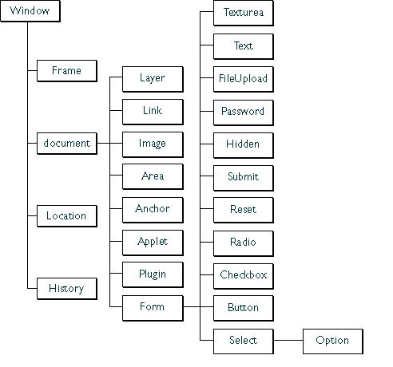
HTML DOM Structure
The nodes in the node tree are placed in a hierarchy.
The terms parent, child, and sibling are used to describe the relationships.
Parent nodes have children.
Children on the same level are called siblings, are nodes with the same parent.
In a node tree, the top node is called the root.
Every node, except the root, has exactly one parent node.
A node can have any number of children .
A leaf is a node with no children.
Elements can be accessed by moving through the tree nodes. Example: To access the text field element we use document.form.text.

Slide 8
Accessing Elements Using getElementsByTagName
getElementsByTagName() retrieves all the elements with a specified tag name.
Scenario: Assume that there is a HTML with many paragraph elements <P></P>.
How can one access the first paragraph tag in the document?
document.getElementsByTagName("p")[0];
Where,
document.getElementByTagName(“p”) return a list of all the paragraph tags in the page and index [0] returns the first tag in the list.
How read the contents inside the first paragraph tag in the document?
var content=document.getElementsByTagName("p")[0].innerText;

Slide 9
Accessing Elements Using getElementsByName
getElementsByName() method used for accessing a specific element using its name.
var choice=document.getElementsByName(“hobby”); Gets all the elements with the name “hobby”.
Individual elements can be accessed from the collection using the index.
hobby[0] returns the first element in the collection choice
Length property gives the number of elements in the collection can be used to iterate through the entire list of elements.
Value of the individual elements can be retrieved using the value property.
Scenario : Assume “hobby” is the name of a collection of check boxes with values “Singing, Dancing, Cricket” in a html page.
How to identify which hobbies are selected?
var choice=document.getElementsByName(“hobby”);
for(var i=0;i<choice.length;i++){
alert(choice[i].checked);}
This iterates through the hobbies check boxes and using the checked attribute and alerts whether it is checked or not.

Slide 10
How To Access Fields using
getElementById() method
To access the form fields we use the method document.getElementById().
Example of Fields: Text box, Radio button, Check box , text area etc.
Syntax : document.getElementById(elementID) // This retrieves the element whose id matches the id passed as parameter. “Id” here refers to the ID attrbute of the form element.
Example: How to access a text field “user name” whose id is “username”.
document.getElementById(“username”)
Notes:
To the Trainer
The trainer should explain about DOM while explaining this slide. DOM stands for document object model. An HTML page when loaded in the browser will be converted into a DOM according the tags.
Some tags like textbox, textarea, radio button have the value attribute .
Some tags like span, label etc have the innerhtml attribute which returns the text in between the tags.
After this slide the trainer should ask the associates to create a javascript file for validating the username and password fields in the login.html page for null values.
Create a folder scripts in the webcontent directory
Create a javascript file in the scripts folder
Write the below code in the script file
function validate() {
var userName=document.getElementById("userName").value;
var password=document.getElementById("password").value;
var isValid=true;
if(userName.length==0)
{
document.getElementById("errorSpan").innerHTML="User Name Cannot be Empty";
isValid=false;
}
else if(password.length==0)
{
document.getElementById("errorSpan").innerHTML="Password Cannot be Empty";
isValid=false;
}
return isValid;
}
Create an error span in login html page above the table
<span id="errorSpan"></span>
Import the js file into the html
<head>
<meta http-equiv="Content-Type" content="text/html; charset=ISO-8859-1">
<title>Login</title>
<script type="text/javascript" src="scripts/validations.js"></script>
</head>

Slide 11
How to access and set values of form elements.
To retrieve the value of an element we use the attribute “value”.
Syntax:
// retrieves the value
var variableName=document.getElementById(elementId).value
// Sets the value
document.getElementById(elementId).value = value To Be Set.
Example:
//This retrieves the value from the text field “userName”
var userName=document.getElementById(“username”).value
//This sets the value of username as “Arun” in the text field “userName”
document.getElementById(“username”).value=“Arun” ;
Notes:
To the Trainer
The trainer should explain about DOM while explaining this slide. DOM stands for document object model. An HTML page when loaded in the browser will be converted into a DOM according the tags.
Some tags like textbox, textarea, radio button have the value attribute .
Some tags like span, label etc have the innerhtml attribute which returns the text in between the tags.
After this slide the trainer should ask the associates to create a javascript file for validating the username and password fields in the login.html page for null values.
Create a folder scripts in the webcontent directory
Create a javascript file in the scripts folder
Write the below code in the script file
function validate() {
var userName=document.getElementById("userName").value;
var password=document.getElementById("password").value;
var isValid=true;
if(userName.length==0)
{
document.getElementById("errorSpan").innerHTML="User Name Cannot be Empty";
isValid=false;
}
else if(password.length==0)
{
document.getElementById("errorSpan").innerHTML="Password Cannot be Empty";
isValid=false;
}
return isValid;
}
Create an error span in login html page above the table
<span id="errorSpan"></span>
Import the js file into the html
<head>
<meta http-equiv="Content-Type" content="text/html; charset=ISO-8859-1">
<title>Login</title>
<script type="text/javascript" src="scripts/validations.js"></script>
</head>

Slide 12
How To set the element inner text?
To set the text in between the tags we use the attribute innerHtml. This is used to set text between container tags.
Example: Span or div tag.
Syntax : document.getElementById(elementId).innerText=text value
Example: document.getElementById(“errorSpan”).innerText=
“Password cannot be empty”.
The above statement sets the error message as the text inside the span tag with id “errorSpan”.

Slide 13

Before We Proceed
Confused with all the methods?
A quick recap on what we learnt,
getElementsByTagName() is used to get a collection of elements of the same type (example paragraph tags etc.).
getElementsByName() is used to get a collection of elements with the same name. (example to access radio button groups, check box groups etc). By iterating through the collection the individual elements can be accessed.
getElementById() can be used to directly access an individual element.
Value property can be used to get or set the values of elements having a value attribute. Used to read values from the form controls.
InnerText and InnerHTML properties can be used to get and set the text/html contents which appears between the start tag and end tag.

Slide 14
InnerText Vs InnerHTML
For updating the contents of a div tag we have two options in IE
innerHTML
innerText
Text inserted using Inner html will be considered as HTML tags and parsed rather innerText includes it as normal text.
Example:
Var text=“<b>This is a Text</b>”
document.getElementById(“div1”).innerHTML=text;
document.getElementById(“div2”).innerText=text;
Output:
div1 value : This is a Text
div2 Value: <b>This is a Text</b>
Guess The output.
Text made bold by the <b> tag, since it is parsed as HTML.
The tag is not parsed and displayed as it is.

Slide 15
JavaScript Events
Events are automatically triggered based on some user actions (or) browser events in a html page .
Example:
Browser triggers onLoad event when it loads the HTML page.
User Clicking a button or control triggers onClick event of the button/control.
Following are JavaScript pre-defined events:
onBlur
onChange
onClick
onError
onFocus
OnKeyup
OnKeyDown
OnKeyPress
onLoad
onMouseOut
onMouseOver
onReset
onSelect
onSubmit
onUnload
onAbort
The highlighted ones will be explained in the coming slides.

Slide 16
JavaScript Events
Event | Description
onBlur | The event occurs when a form element loses focus.
onChange | The event occurs when the content of a text field/text area (or) drop down (or) the check box has changed
onClick | The event occurs when the user clicks any form element.
onKeyUp | The event occurs when a keyboard key is released when focused in textbox/text area..
onLoad | The event occurs after an HTML page has been loaded.
onMouseOut | The event occurs when a user moves the mouse pointer out of an element.
onSubmit | The event occurs when a form is submitted using the submit button.

Slide 17
Lend a Hand
Statement: In this exercise we will familiarize how java script functions can be invoked on different events and use span tags to display messages based on different events.
Problem # 1 : Create a page containing a text box whose text should be read and written to a span when the control is exited from the text box.
Problem # 2: On load of the page the span tag should display a welcome message.
Problem 3: On clicking a button a message to be displayed in a span tag stating “Hey You clicked me”

Slide 18
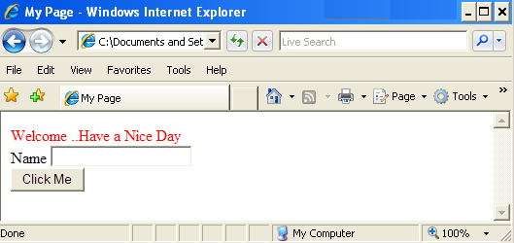
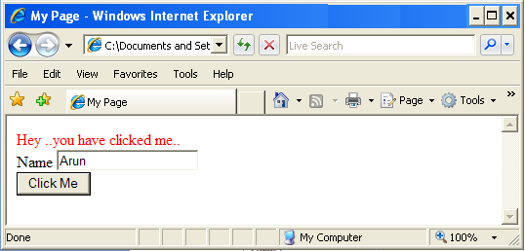
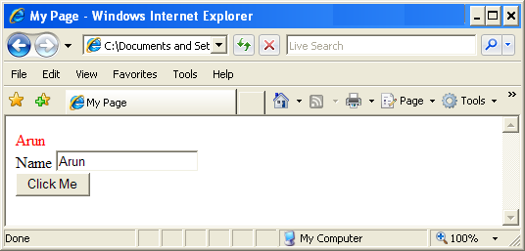
Lend a Hand – myPage.html Design
The page should contain a message when it gets loaded.
Click the button to get the message as shown in the figure below
Type the name in the Text box and click the mouse outside the text box to get the name printed as shown in the figure below

Slide 19
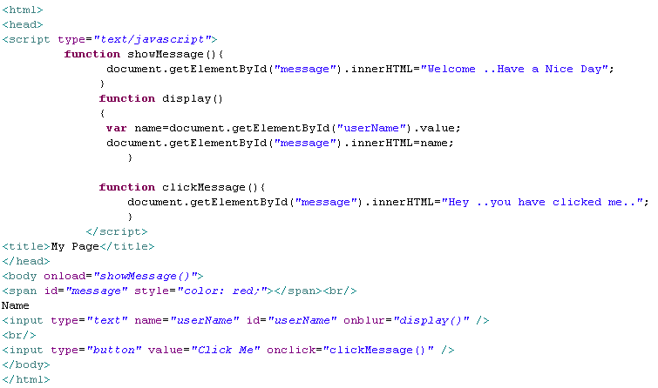
Lend a Hand – myPage.html Source
Invokes the showMessage method on the onLoad event
Invokes the display method on the onBlur event
Invokes the clickMessage method on the onClick event

Slide 20
JavaScript Built-in Objects
The following are built in objects in JavaScript
Date – Used for processing date.
Math – Used for performing math functions.
String – Used for manipulating Strings.
Array – Used for processing Array.
Boolean – Used for storing boolean values.
RegEx – Used for performing regular expressions.
We will be explaining the highlighted ones in the coming slides.

Slide 21
Date Object
The Date object is used to work with dates and times.
Date objects are created with the Date() constructor.
There are four ways of instantiating a date:
new Date() // current date and time
new Date(milliseconds) //milliseconds since 1970/01/01
new Date(dateString) // creates the date object from the string.
new Date(year, month, day, hours, minutes, seconds, milliseconds) - Constructs a date based on the parameters, the parameters are optional. Default value is zero.The month count start from 0 that is January is 0 and December will be 11
Examples:
var today = new Date()
var d1 = new Date("October 13, 1975 11:13:00"

Slide 22
Date Object –Some Important Methods
Assuming a date object with value 25th February 2012. Created using
var now=new Date(2012,01,25,10,45,52,55);
Method | Description | Example
getDate() | Returns the day of the month (1-31). | now.getDate() returns 25
getDay() | Returns the day of the week as a number (0-6, 0=Sunday, 6=Saturday). | now.getDay() returns 6 since 25th February 2012 was a Saturday
getMonth() | Returns the month as a number (0-11, 0=January, 11=December). | now.getMonth() returns 1 denoting February.
getFullYear() | Returns the four-digit year. | now.getFullYear() returns 2012
getHours() | Returns the hour (0-23). | now.gethours () returns 10
getMinutes() | Returns the minute (0-59). | now.getMinutes() returns 45
getSeconds() | Returns the second (0-59). | now.gethours () returns 52
getMilliseconds() | Returns the millisecond (0-999). | now.gethours () returns 55
For more methods visit http://www.w3schools.com/jsref/jsref_obj_date.asp

Slide 23
Math Object
The Math Object type provides API’s for performing mathematical operations on numbers.
Method | Description | Examples
Math.abs(number) | Returns the absolute value of number. | Math.abs(-7.25) returns 7.25
Math.ceil(number) | Number rounded up. | Math.ceil(5.1) returns 6 Math.ceil(-5.9) returns -5
Math.floor(number) | Number rounded down. | Math.floor(5.1) returns 5 Math.floor(-5.9) returns -6
Math.max(numbers) | Highest Number in numbers. | Math.max(5,10,2) returns 10
Math.min(numbers) | Lowest Number in numbers. | Math.min(5,10,2) returns 2
Math.pow(number, power) | number to the power of power. | Math.pow(2,3) returns 8
Math.round(number) | Rounded number. | Math.round(5.49) returns 5 Math.round(5.50) returns 6
For Details Visit http://www.w3schools.com/jsref/jsref_obj_math.asp

Slide 24
String Object
The String Object type provides a set of methods for manipulating strings.
Example: var string1=“Hello World” and var string2=“JavaScript”
Method | Description | Example
charAt(index) | Returns the character at the specified index | string1.charAt(0) returns “H”
charCodeAt(index) | Returns the Unicode of the character at the specified index | string1.charAt(0) returns 72 which is the Unicode value for “”H
fromCharCode(unicode1,unicode2) | Converts Unicode values to characters | String.fromCharCode(72,69,76,76,79)) returns “HELLO” where the numbers 72,69,76,79 are the Unicode's of the letters H,E,L and O respectively.
indexOf(string) | Returns the position of the first found occurrence of a specified value in a string | string1.indexOf(“World”) returns 6
lastIndexOf(string) | Returns the position of the last found occurrence of a specified value in a string | string1.lastIndexOf(“o”) returns 7

Slide 25
String Object Methods
Method | Description | Example
match(regEx) | Searches for a match between a regular expression and a string, and returns the matches | Visit the below link for details on using regEx. http://www.w3schools.com/js/js_obj_regexp.asp
replace(stringA,StringB) | Searches for a match between a substring (or regular expression) and a string, and replaces the matched substring with a new substring | string1.replace(“World”,”John”) returns “Hello John”
search(regEx) | Searches for a match between a regular expression and a string, and returns the position of the match | Visit the below link for details on using regEx. http://www.w3schools.com/js/js_obj_regexp.asp
substr(start,length) | Extracts the characters from a string, beginning at a specified start position, and through the specified number of characters. length is optional in that case the rest of the string from the starting index is returned. | string1.substr(3,4) returns “lo w”
substring(start,stop) | Extracts the characters from a string, between two specified indices excluding the stop index. stop index is optional in that case the rest of the String starting from the start index is returned. Negative values become zero. if start > end, the arguments are swapped | String1.substring(3,5) returns “lo”

Slide 26
String Object Methods
Method | Description | Example
slice() | Returns a portion of the string from position start to, but not including position end. Normally Works similar to substring() method but for negative arguments it means go backwards from the tail. | String.slice(4,-2) returns “o wor” that is from 4th index to 2nd position from the tail.
toLowerCase() | Converts a string to lowercase letters | string1.toLowerCase() returns “hello world”
toUpperCase() | Converts a string to uppercase letters | String1.toUpperCase() returns “HELLO WORLD”
concat(string) | Joins two or more strings, and returns a copy of the joined strings | string1.concat(string2) returns “Hello WorldJavaScript”

Slide 27
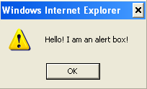
Pop up windows
Pop ups are small windows used for either getting user input (or) displaying alert messages. There are three types of popup boxes
1. Alert Box
Generally, the alert() method is used to warn the user on something.
Example of usage:
Displayed when incorrect information input in a form.
An invalid result from a calculation.
A warning that a service is not available on a given date.
Syntax:
alert(“Hello ! I am an alert box!”)
When an alert box pops up, the user will have to click "OK" to proceed.

Slide 28
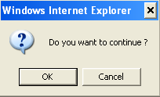
Pop Up Window – Confirm Box
A confirm box is often used if you want the user to verify or accept something.
When a confirm box pops up, the user will have to click either "OK" or "Cancel" to proceed.
If the user clicks "OK", the box returns true. If the user clicks "Cancel", the box returns false.
Syntax:
var value=confirm(“Confirm Text ?”)
Example:
var value=confirm(“Do you wish to continue ?”)

Slide 29
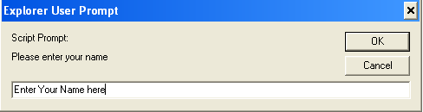
Pop Up Window- Prompt Box
A prompt box is often used if you want the user to input a value before entering a page.
When a prompt box pops up, the user will have to click either "OK" or "Cancel" to proceed after entering an input value.
If the user clicks "OK" the box returns the input value. If the user clicks "Cancel" the box returns null.
Syntax:
var variable= prompt(“Prompt Text", “Default Value") ;
Example:
var name=prompt("Please Enter your name", "Enter Your Name Here") ;

Slide 30

Time To Reflect
Associates to quickly summarize the following before ending the session
How can use read the value from a text box field using JavaScript?
What is the difference between innerHtml and innerText?
What is the difference between a alert box and a confirmation box?
What are all the ways by which one access the HTML form elements?

Slide 31
Lend a Hand – Pop Up boxes
Objective: Demonstration to learn the usage of confirm and alert box.
Pre-requisite: Remove the display method and the onBlur event.
Problem Statement # 1: Let us extend the previous lend a hand for this demo. If the entered name is empty alert the user stating that the name cannot be empty.
Problem Statement # 2: On entering the correct name and clicking “Go” a confirmation box to be displayed clicking “yes” (or) “no” the appropriate messages to be displayed.
To be developed:
Add a “ENTER” button to the page
Create a java script method validate to display alert and confirmation box and invoke the method on the button click.

Slide 32
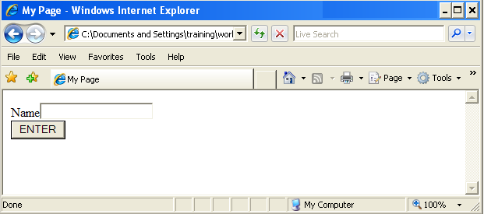
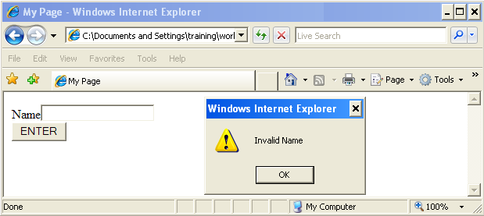
Lend a Hand – Design of myPage.html
Empty user name entered

Slide 33
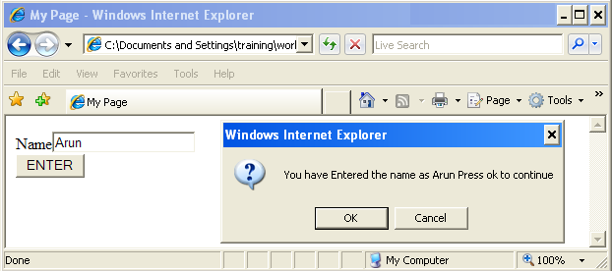
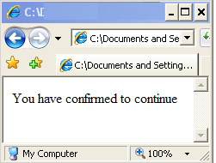
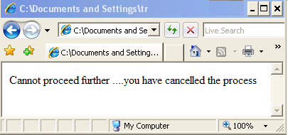
Lend a Hand – Design myPage.html
Valid user name
Ok pressed
Cancel pressed

Slide 34
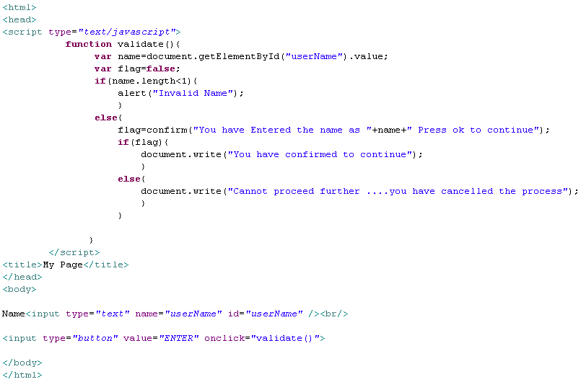
Lend a Hand – Source Code

Slide 35
Lend a Hand – Form Validation
Objective: To learn how to validate HTML form fields using java script.
To be Developed :
We will reuse myPage.html by making the necessary modifications as given below
Add radio buttons for gender
Add the controls inside a HTML form .
Change the button type to submit.
B. ActionServlet servlet : The action servlet for the myPage.html which will be invoked only when the html page passes all the validation checks.
Problem : User on clicking the enter button the user name needs to be validated for a valid name. If the text field is empty an error “User name cannot be empty” must be displayed. If the gender is not selected throw an error “Please Select a Gender”. If all the validations are passed the page is submitted to the action servlet ActionServlet.
Since using alert to show validation messages is not a good practice we will use span tags to show the error messages.

Slide 36



Lend a Hand – Design myPage.html
HTML Form
Name Field Empty
Gender Radio Button not selected

Slide 37
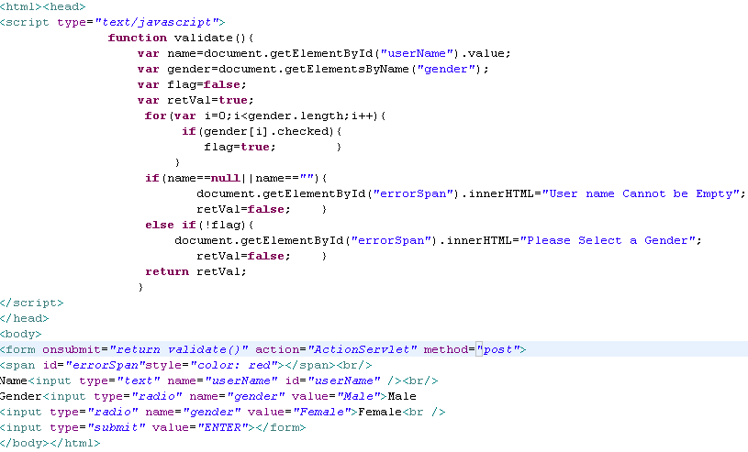
Lend a Hand – Solution
Reads the value of the text box with id uname
Reads the radio box group with name gender
Iterated through the radio box collection and checks whether a gender is selected or not.
If user name not entered the error message is set to the error span
If gender is not selected the error message is set to the error span
Returns the validation flag
Onsubmit event invokes the validate method .The form is submitted to the server only if the validate method returns true.
This method can also be invoked on the submit button onClick event.

Slide 38
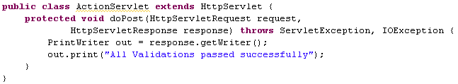
Lend a Hand- Action Servlet
Action servlet to handle the response if all the validations are successful.

Slide 39
Lend a Hand-Deploy and Run
Open the HTML page in the browser
Submit the from without entering the user name. The error message “User name cannot be empty” should be displayed.
Specify a valid user name and try to submit the form without selecting any gender. The error message “Gender cannot be empty” should be displayed.
If all the validations are passes the request hits the action servlet and the success message is shown.

Slide 40
Lend a Hand – Registration page
In this demo we are going to familiarize how JavaScript can be used for form validation.
Objective :
Create an user registration page. To reduce the network traffic and to improve the response time the client have asked you to perform client side validation using JavaScript. Only if all the validations passes the form must be submitted to the server.
Requirements:
The registration page should contain the fields specified.
Proper JavaScript validation should be performed before submitting the form to the server
The registration page should contain the current date printed on the top

Slide 41
Lend a Hand – Registration Form Fields
User Name Text box – To enter the user name
Last Name Text box - To enter the last name
Email ID Text box - To enter the email ID
Phone Number Text box – To enter the phone number
Country Drop down -Drop down menu to list the countries. There should be an option to enter the country name in a text box if the country name of the user’s choice is not present in this list. For this an option called “Others” should be provided.
Country Text box : To enter the country name if the user’s choice not available in the country drop down. Should be invisible by default. Should be displayed when the user selects the option “Others” in the drop down.
Gender radio button : To enter the gender of the user :
Submit button : To submit the form to the server
Get Google Help Button : An button which when clicked redirects the user to the Google home page.

Slide 42
Lend a Hand – Validation Requirements
Field | Validation
User name text box | Mandatory
Last Name Text box | Mandatory
Email ID Text box | Mandatory, The email ID should be entered in a valid format for example. xyz@abc.com .
Phone Number Text Box | The phone number field should contain only numbers
Country Drop down | If the option others is selected, the country text box should be made visible on the change event of the drop down.
Radio Button | At least one value should be selected.

Slide 43
Lend a Hand – Components to be Created
Registration.jsp : The registration page with all the form controls explained in previous slide.
UtilsScript . js : Contains the functions for printing the current date and opening google site.
Validations.js : Contains the java script functions for the required form field validations.
FormatValidations.js : Contains the java script functions for validating the format of the entered data.
ActionServlet servlet: The action servlet for the registration page which will be hit only when all the validations are passed. The ActionServlet developed in the previous lend a hand can be reused.

Slide 44
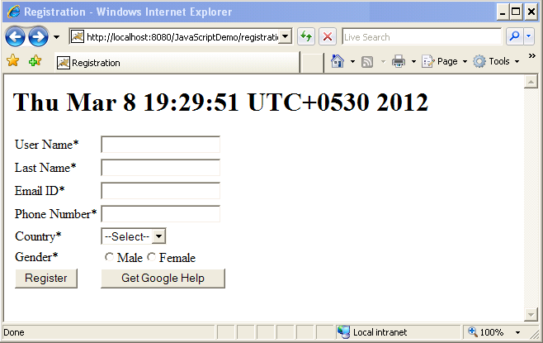
Lend a Hand – Registration page Design

Slide 45
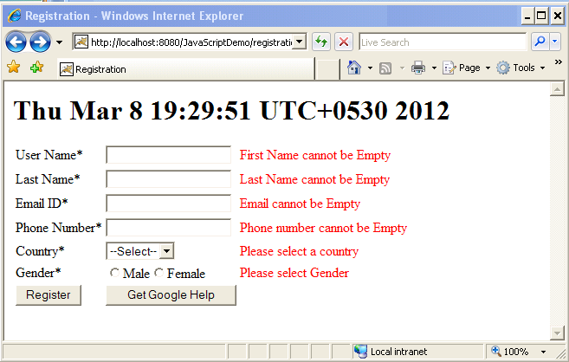
Lend a Hand – Registration page with validation messages

Slide 46
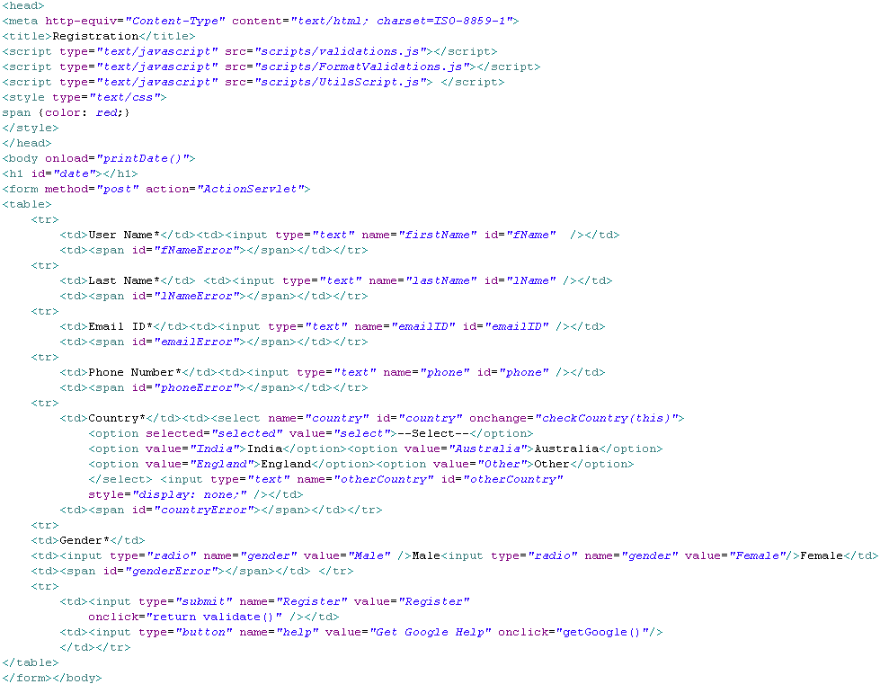
Lend a Hand- Registration.jsp Code
External java script files imported
Invokes the java script method printDate on the page load event
Invokes the checkCountry() method on the change event
On click invoke the validate method .Since return Validate () is used , form will be submitted only if the validate method returns true
Invoke the method getGoogle() which loads google home page

Slide 47
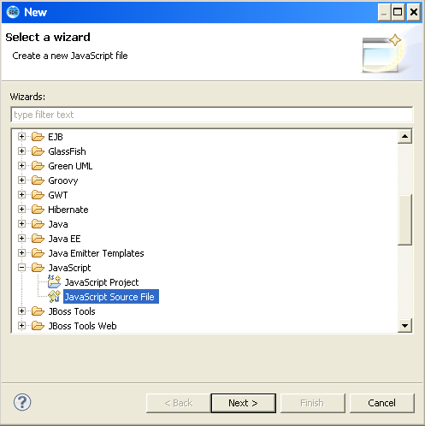
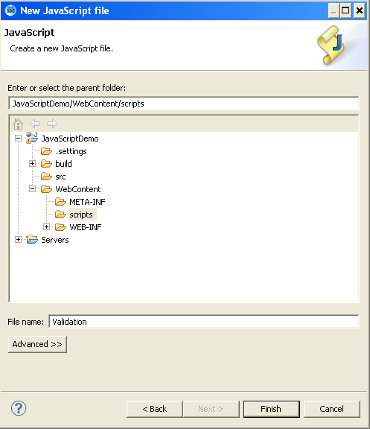
Lend a Hand- Creating JavaScript files
Step 1 : Create a folder named “scripts” inside the webcontent directory
Step 2 : Right click “scripts”→ new →Other→ java script source file
Enter the file name and finish

Slide 48
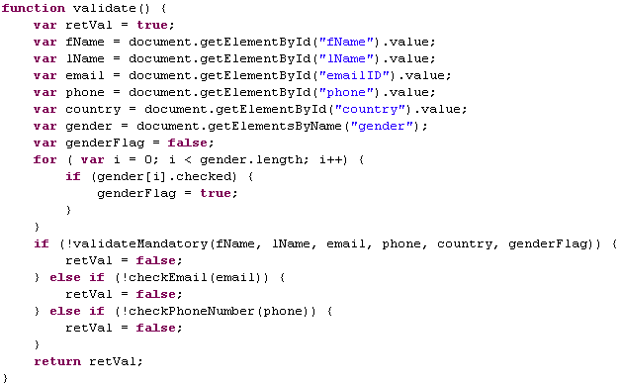
Lend a Hand – Validate.js – validate Method
Add the following function to validate.js file
Reads the form element values
Reads the radio button group
Gets the radio button check status
Calls the other validator methods

Slide 49
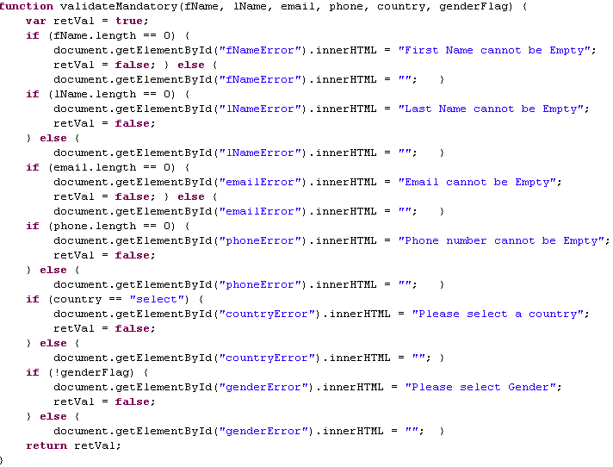
Lend a Hand – Validate.js – validate Method
Add the following function to validate.js file
Checks if the fields are null. Then set the error messages to the corresponding error spans and returns false. Else clears the error message span

Slide 50
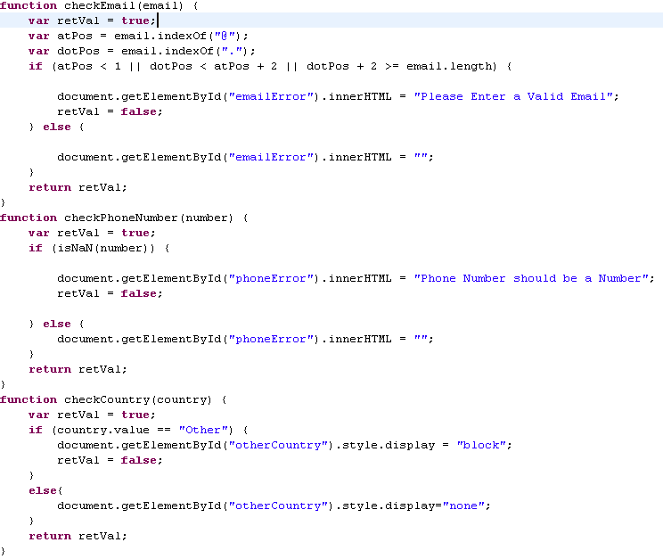
Lend a Hand- FormatValidations.js
Checks the email format.
Valid format: Email must contain an @ sign and at least one dot (.). The @ must not be the first character of the email address, the dot must be present after the @ sign and minimum 2 characters before the end
Checks if the entered phone number is an integer . isNaN() function return true if the entered data is not a valid number
Displays the text box if the “other” option is selected in the drop down. This is done by setting the display property of text box as “block”

Slide 51
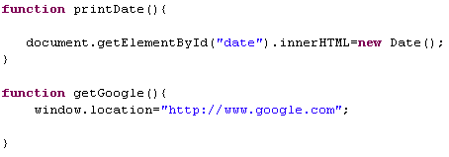
Lend a Hand- UtilScripts.js
Gets the current date and sets it to the date element in the page
Loads google home page

Slide 52
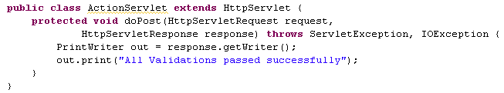
Lend a Hand- Action Servlet
Action servlet to handle the response if all the validations are successful.

Slide 53
Lend a Hand - Deploy and Run
Step 1 : Deploy and run the application
Step 2 : Invoke registration.jsp from the browser
Step 3 : Submit the page with some null values and check whether the error messages are getting printed
Step 4 : Enter invalid email format and check whether email validation is happening properly.
Step 5 : Enter character in phone number field and check for phone number validation.
Step 6 : Select the option “Other” in the country list and see whether the textbox is getting displayed.
Step 7: Enter valid values in all the fields and check whether the success page is displayed.

Slide 54
Advance Java
You have successfully completed – JavaScript Basics

